Slide 1
Spatial analyses: Correlograms and dbMEM
Elizabeth Bowman
Arnold lab workshop
Spring 2017

Slide 2
What are these tests and why do we use them?
Ecologists are interested in understanding how communities are structured spatially and temporally
There are different influences at different scales
abiotic (climate, physical, chemical)
biotic (dispersal limitations, top-down processes)
historical events (disturbance)
Generally these factors are spatially structured
Family of analyses used are called Surface Trend Analysis
Notes:
condition of second order stationarity: uniform mean, covariance, and variance

Slide 3
Surface trend analysis
Spatial correlogram (Numerical Ecology, Ch13)
Mantel correlogram (Numerical Ecology, Ch13)
Distance Based Moran’s Eigenvector Maps (Numerical Ecology, Ch14)
Notes:
condition of second order stationarity: uniform mean, covariance, and variance

Slide 4
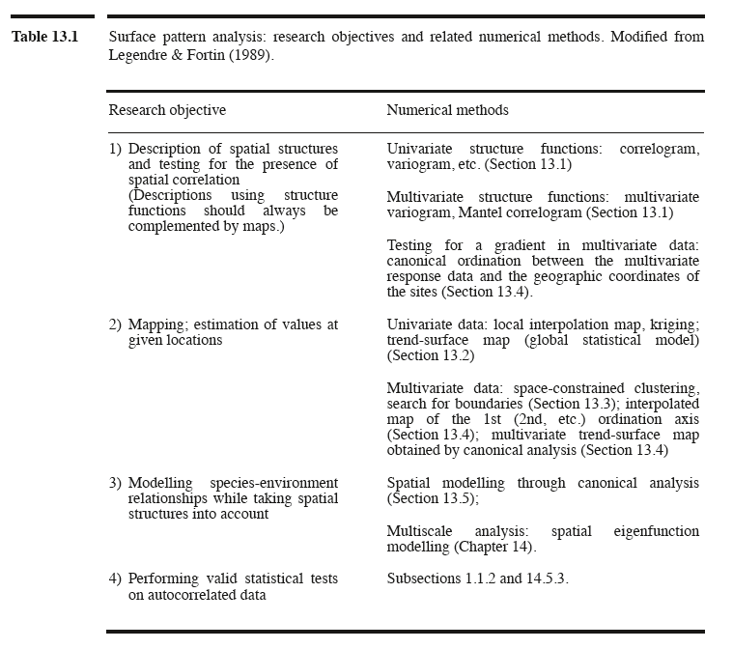
Surface trend analysis
Numerical Ecology
Notes:
condition of second order stationarity: uniform mean, covariance, and variance

Slide 5
Spatial correlograms
Allows modelling of spatial structures
Plots some index of autocorrelation against distance classes
Moran’s I
Geary’s c
Univariate data
Quantitative variables
Useful explanatory and descriptive tool

Slide 6
Distance and dissimilarity matrices
Computes differences between pairs of observations
Many different formulas for computing distances
Euclidean is most commonly used with geographical distances and environmental variables
x
1
3
2
10
 | 1 | 3 | 2 | 10
1 | 0 | 2 | 1 | 9
3 | 2 | 0 | 1 | 7
2 | 1 | 1 | 0 | 8
10 | 9 | 7 | 8 | 0

Slide 7
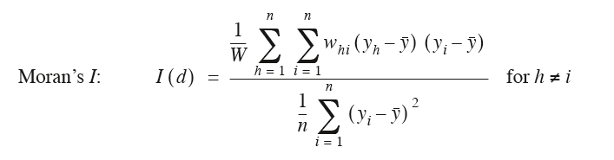
Moran’s I
Similar to Pearson’s correlation coefficient although some differences
Ranges from -1 to +1
A positive I translates to a positive spatial correlation in the data
A negative I translates to a negative spatial correlation in the data
Notes:
Numerator is covariance or a measure of the strength of correlation of two variables (yh and yi). W(hi) is a weight for each distance class. If it falls within that distance class, then the weight will be 1 (or some other value) if that point is outside that distance class then w is 0, so that value is removed
Geary’s c 0 to some number larger than 1. if c is < 1, positive spatial correlation, if >1 negative. low values of c mean strong correlation.

Slide 8
Determination of distance classes
Number of distance classes is arbitrary
Narrower classes increases the resolution of the correlogram
More pairs in a distance class increases the power of the test
Different ways to have distance classes
Distance classes can be equal widths
Distance classes can contain the same number of pairs of observations
Notes:
Numerator is covariance or a measure of the strength of correlation of two variables (yh and yi). W(hi) is a weight for each distance class. If it falls within that distance class, then the weight will be 1 (or some other value) if that point is outside that distance class then w is 0, so that value is removed
Geary’s c 0 to some number larger than 1. if c is < 1, positive spatial correlation, if >1 negative. low values of c mean strong correlation.

Slide 9
Distance classes
4
5
2
1
2
3

Slide 10
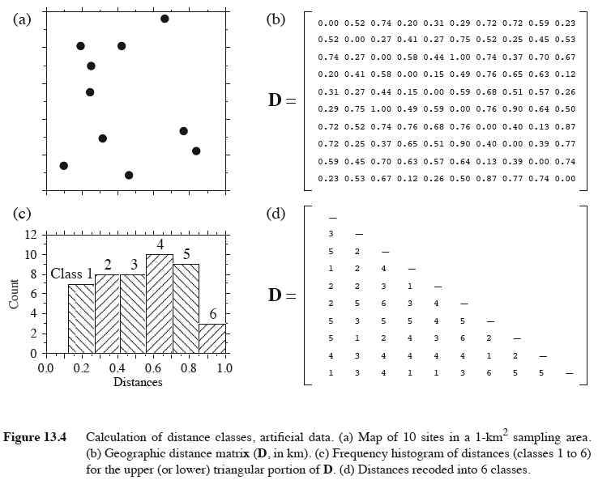
Distance classes

Slide 11
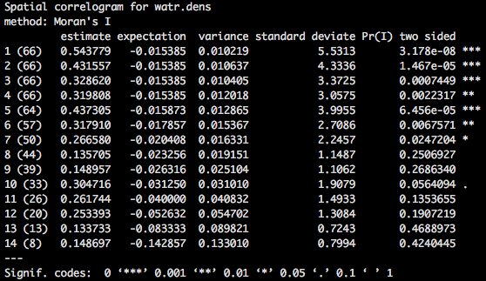
Correlogram

Slide 12
Mantel test and mantel correlograms
Originally developed to evaluate for the study of diseases
Regression assumes independence of observations
Contents of distance matrices are not independent from one another
x
1
3
2
10
 | 1 | 3 | 2 | 10
1 | 0 | 2 | 1 | 9
3 | 2 | 0 | 1 | 7
2 | 1 | 1 | 0 | 8
10 | 9 | 7 | 8 | 0

Slide 13
Mantel test: what are you testing
Evaluates correlation between distance or dissimilarity matrices
Do samples that are similar in terms of the predictor (environmental) variables also tend to be similar in terms of the dependent (species) variable?
Null: there is no correlation between the predictor variable and the dependent variable.

Slide 14
Mantel test: requirements
Matrices must be of the same dimensions
Matrices must refer to the same objects in the same order
You are comparing different aspects of the same sampling units

Slide 15
Mantel test: basics
Tests the significance of the correlation
Results of repeated randomizations are compared to the observed matrix
How often do randomizations result in correlations as strong as or stronger than that observed
Based on this test, you get a mantel statistic (r) and and a p-value

Slide 16
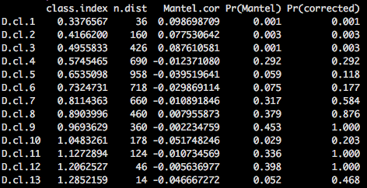
Mantel correlogram

Slide 17
Distance based Moran’s Eigenvector Maps
Originally called principal coordinates of neighbor matrices (PCNM)
Allows modelling of more complex spatial structures

Slide 18
dbMEM: basics
Construct a matric of Euclidean distances among sites
Truncate matrix to retain only the distances among close neighbors
Compute a PCoA of the truncated distance matrix
generally only the positive eigenfunctions are retained
this is done if you are only interested in positive spatial correlation
Use the eigenvectors as spatial explanatory variables

Slide 19
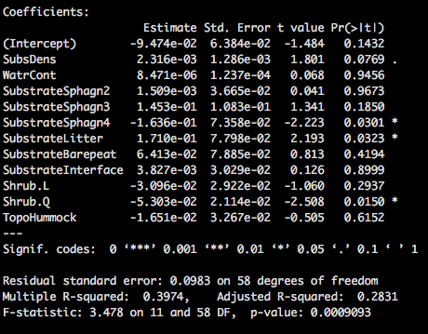
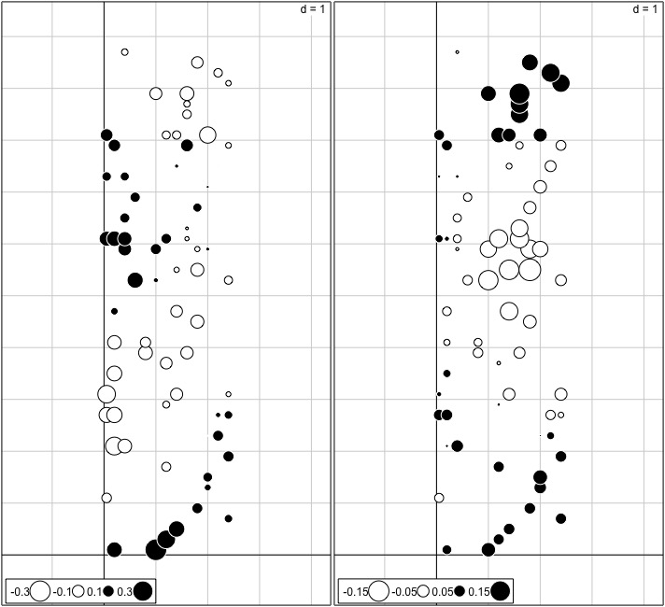
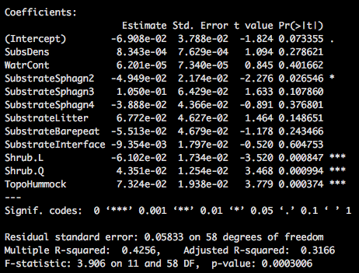
Axis 1
dbMEM: basics
Axis 2

Slide 20
References
McCune and Grace. 2002. Analysis of ecological communities. MjM Software Design.
Borcard, Gillet, and Legendre. 2011. Numerical ecology with R. Springer.
Numerical ecology

